Slide 1
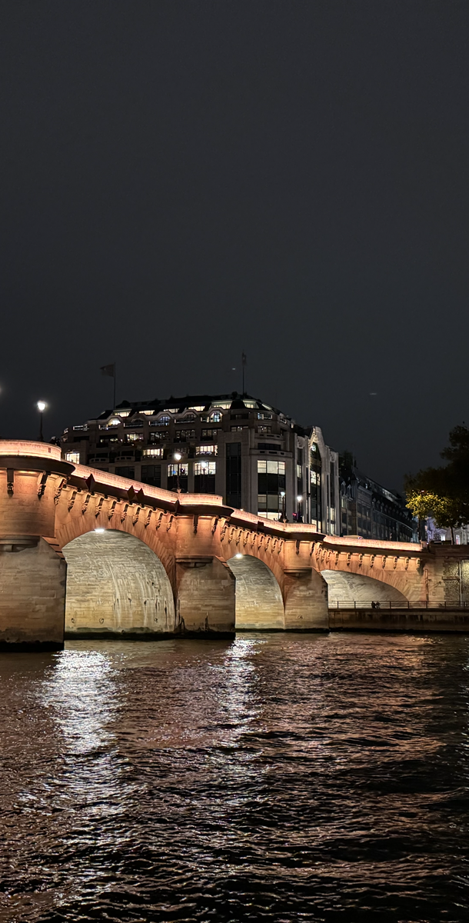
About this template
This PowerPoint template is designed to easily create square visuals for social media posts (LinkedIn, X, etc.) related to the Aptitude Kick-off. It allows you to quickly generate a branded image featuring the participant’s photo, name, title, organisation, and optionally their logo.
How to use it:
Duplicate the example slide and replace the placeholders with your own content (photo, text, logo).
Adjust the layout if necessary to ensure balance and visibility.
Once the slide is ready, go to:
File → Export → Change File Type → PNG image
Choose “Just This Slide” to export your visual.
The exported image is now ready to be shared on social media.
💡 Tip: Keep text short and visuals clean — the square format is ideal for LinkedIn posts and event highlights.

Slide 2
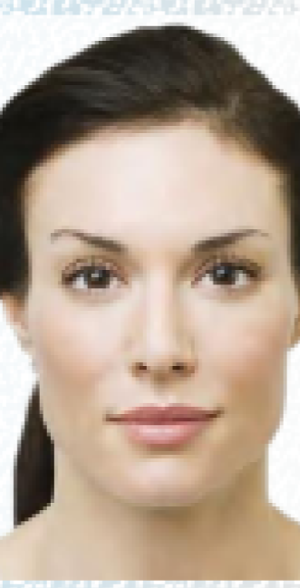

Maëlys-Gaëlle MARTIN
Observer
French identity
France Titres Ministère de l’intérieur

